Slide 1
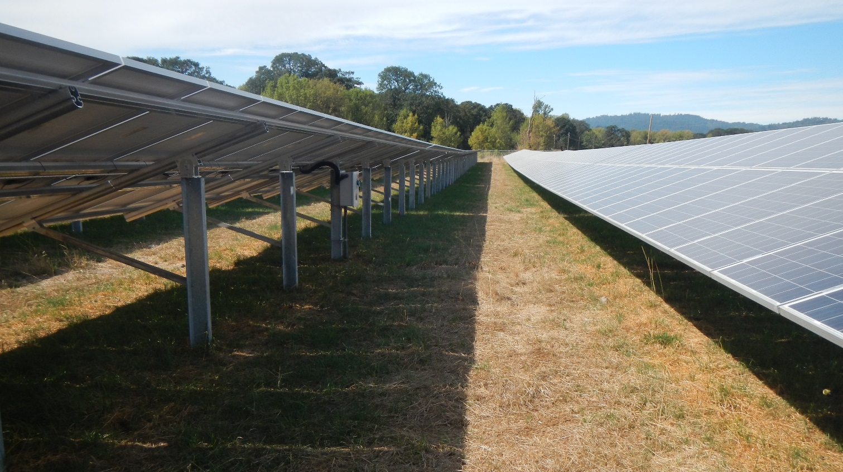
Prepared by Chad Higgins
Dual-use (agrivoltaic) systems benefit the agricultural industry and the energy industry.
Image of dual-use sheep pasture field location, late August
Chad Higgins, Elnaz HassanPour, Steve Good, John Selker, Marc Calaf
Green
Brown

Slide 2
A high-functioning dual use system
Cooler PV panels produce more energy
solar excess
We can measure all of this!
Shade % reduces water demands, plant stress
Plant transpiration cools microclimate
Less stressed plants produce more food, better food
Reduced agricultural water demand leaves more water available.

Slide 3
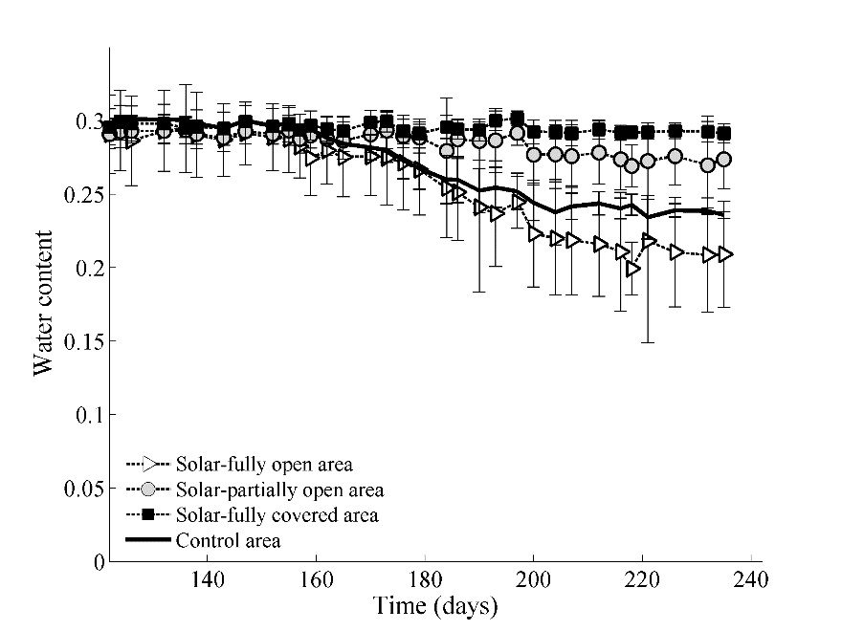
more water available for longer under panels
Orientation, the dashed diagonal is the noon shadow front in August for reference
SFC = solar fully covered (full shade)
SPO = solar partially open (partial shade)
SFO= Solar Fully open (no shade, but in array area)
Fig 4: Soil moisture time series (a) 0.2m, (b) 0.4m and (c) 0.6m. For more information: there was 40 mm precipitation over the observation period, i.e. May-Aug 2015.

Slide 4
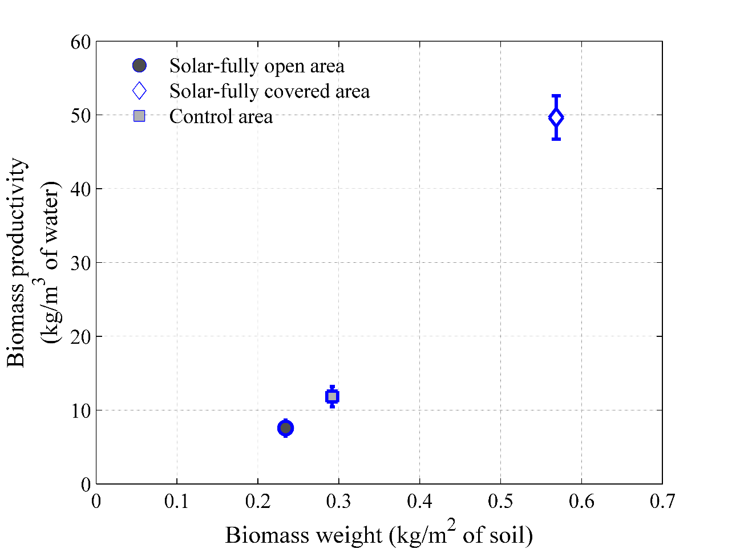
90% more biomass
328% more water efficient

Slide 5
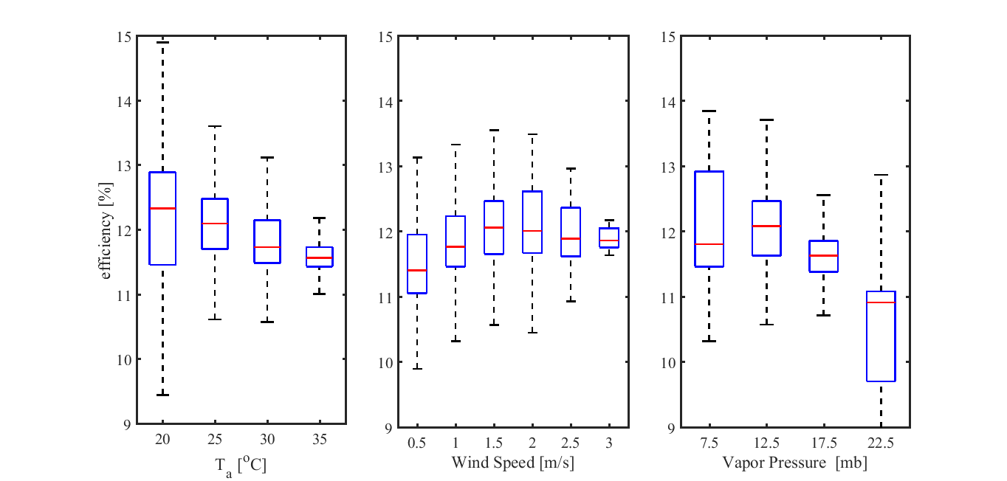
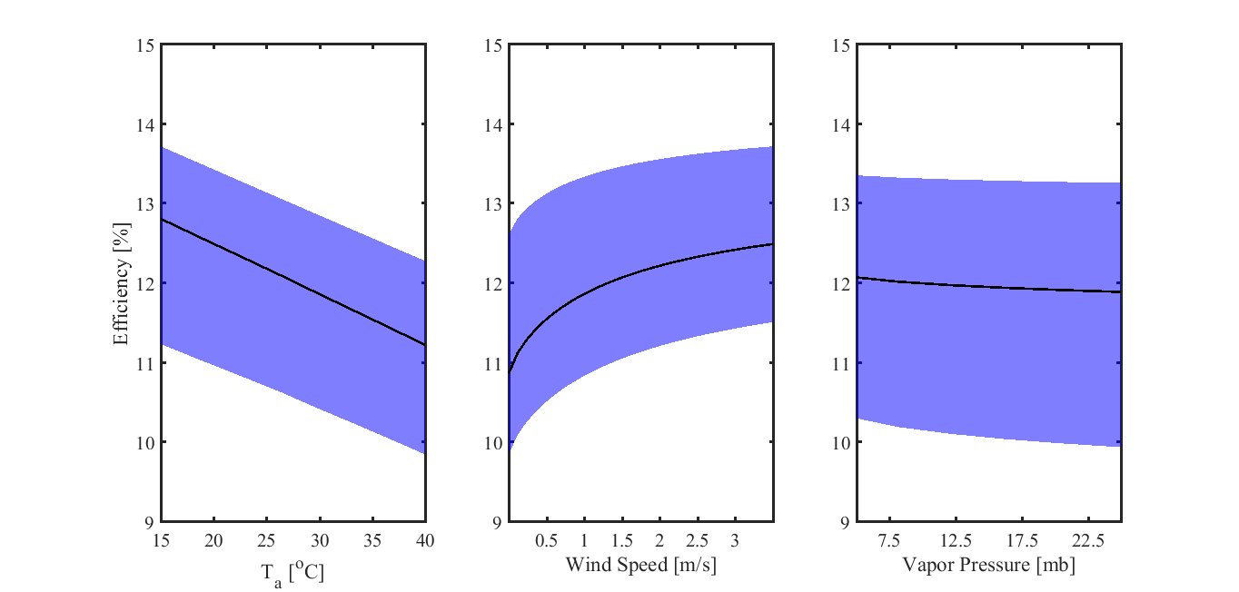
Field data
Solar panel efficiency
decreases with air temp
increases with wind speed
decreases with humidity
Modeled with thermodynamics
Model

Slide 6
Thermodynamic model applied to globe.

Slide 7
Energy potential of solar power ranked by land classification: the best place to put solar panels is on croplands

Slide 8
Solar panels led to an 300%+ increase in the water use efficiency of the cropping system
Solar panels led to a 90% increase in biomass production of the cropping system
Species diversity changed
Solar panels are projected to be more productive when placed over cropping systems

Slide 9
Conclusions
Cooler PV panels produce more energy
Solar panels led to an 300%+ increase in the water use efficiency of the cropping system
Solar panels led to a 90% increase in biomass production of the cropping system
Solar panels are projected to be more productive when placed over cropping systems
solar excess
Shade % reduces water demands, plant stress
Plant transpiration cools microclimate
Less stressed plants produce more food, better food
Reduced agricultural water demand leaves more water available.

Slide 10
Caveats and where we are going
Have only investigated pasture conditions
Results likely to change with irrigation
Measurements ongoing or planned to determine
Nutrient content of forage and soil (in process)
Genetic sequencing of soil microbiology (in process)
Sheep health (In process)
Pollinators (in process)
Tolatoes (on process)
Nursery stock (planned this summer)
Weed, pest and disease impacts (planned, 2020)

Slide 11
Yes there are some interesting results here in support of dual use, but this isn’t the main takeaway….
If you don’t work with Agriculturalists, you are leaving $ on the table.
The takeaway

